Slide 1
Module 7: Cloud, Mobile, and IoT Security
Instructor Materials
Ethical Hacker
Notes:
Ethical Hacker Module 7: Cloud, Mobile, and IoT Security

Slide 2
Instructor Materials – Module 7 Planning Guide
This PowerPoint deck has two parts:
Instructor Planning Guide
Information to help become familiar with the module
Teaching aids
Instructor Class Presentation
Optional slides to use in the classroom
Begins on slide # 7
Note: Remove the Planning Guide from this presentation before sharing it with anyone.

Slide 3
What to Expect in this Module
To facilitate learning, the following features within the UI may be included in this module:
Feature | Description
Avatar | A virtual character representing a subject matter expert adds contextual information to the students' skills and helps them connect the dots by asking open-reflection questions.
Videos | Expose learners to new skills and concepts.
Practice | A variety of formats to help learners gauge content understanding.
Hands-On Labs | Labs designed for working with physical equipment.
Module Quizzes | Self-assessments that integrate concepts and skills learned throughout the series of topics presented in the module.
Module Summary | Briefly recaps module content.

Slide 4
Module 7: Activities
What activities are associated with this module?
Page # | Activity | Activity Name | Optional?
7.1.2 | Practice | Practice - Types of Cloud Services | Recommended
7.1.4 | Practice | Practice - Credential Harvesting | Recommended
7.1.12 | Practice | Practice - Cloud Attack Types | Recommended
7.2.3 | Practice | Practice - Mobile Device Vulnerabilities | Recommended
7.2.4 | Practice | Practice - Attacking Mobile Devices | Recommended
7.2.7 | Practice | Practice - Analyzing IoT Protocols | Recommended
7.2.10 | Practice | Practice - Common IoT Vulnerabilities | Recommended
7.2.13 | Practice | Practice - Management Interface Vulnerabilities | Recommended
7.2.16 | Practice | Practice - Vulnerabilities Related to Containerized Workloads | Recommended
7.3.3 | Module Quiz | Quiz - Cloud, Mobile, and IoT Security | Recommended

Slide 5
Module 7: Best Practices
Prior to teaching Module 7, the instructor should:
Review the activities and assessments for this module.
Try to include as many questions as possible to keep students engaged during a classroom presentation.
Topic 7.1
Explain and discuss NIST (SP) 800-145 about cloud computing services and deployment strategies
Ask students, maybe in small group, to research different cloud deployment models and identify cloud providers related to each model
Discuss different attacks against cloud technologies
Encourage students to complete the Practice - Types of Cloud Services
Encourage students to complete the Practice - Credential Harvesting
Encourage students to complete the Practice - Cloud Attack Types

Slide 6
Module 7: Best Practices (Cont.)
Topic 7.2
Discuss different common mobile device vulnerabilities and attacks
Briefly discuss tools commonly used to perform security research and test the security posture of mobile devices. (Note, Module 10 will cover them in more details.)
Explain the importance of analyzing IoT protocols and IoT security special considerations
Encourage students to complete the Practice - Mobile Device Vulnerabilities
Encourage students to complete the Practice - Attacking Mobile Devices
Encourage students to complete the Practice - Analyzing IoT Protocols
Encourage students to complete the Practice - Common IoT Vulnerabilities
Encourage students to complete the Practice - Management Interface Vulnerabilities
Explain, compare, and contrast concepts of Virtual Machines (VM), hypervisors, and containers
Discuss tools that can be used to scan Docker images for vulnerabilities and assess Kubernetes deployments
Encourage students to complete the Practice - Vulnerabilities Related to Containerized Workloads
Encourage students to complete the Quiz - Cloud, Mobile, and IoT Security

Slide 7

Module 7: Cloud, Mobile, and IoT Security
Ethical Hacker
Notes:
Ethical Hacker Module 7: Cloud, Mobile, and IoT Security

Slide 8
Module Objectives
Module Title: Cloud, Mobile, and IoT Security
Module Objective: Explain how to exploit cloud, mobile, and IoT security vulnerabilities.
Topic Title | Topic Objective
Researching Attack Vectors and Performing Attacks on Cloud Technologies | Explain how to attack cloud technologies.
Explaining Common Attacks and Vulnerabilities Against Specialized Systems | Explain common attacks against specialized systems.

Slide 9
7.1 Researching Attack Vectors and Performing Attacks on Cloud Technologies
Notes:
7: Cloud, Mobile, and IoT Security 7.1: Researching Attack Vectors and Performing Attacks on Cloud Technologies

Slide 10
Researching Attack Vectors and Performing Attacks on Cloud Technologies
Overview
Another trend that poses new security challenges is the migration of computing resources, data, and software to the cloud.
The cloud presents a network without a perimeter, there is no border between a traditional internal network and external users as there is when resources are housed on-site.
This lack of perimeter increases reliance on access control, cloud configuration, and network architecture for security. In addition, cloud applications and data are exposed to the internet via application programming interfaces (API).
Mobile and IoT devices often communicate with applications hosted in the cloud. All these technologies and architectures increase the attack surface and introduce a variety of cybersecurity risks.
Cloud computing security includes many of the same functionalities as traditional IT security, including protecting critical information from theft, data exfiltration, and deletion, as well as privacy.
The National Institute of Standards and Technology (NIST) authored Special Publication (SP) 800-145, “The NIST Definition of Cloud Computing,” to provide a standard set of definitions for the different aspects of cloud computing.
Cloud computing can be broken into the following three basic models:
Infrastructure as a Service (IaaS)
Platform as a Service (PaaS)
Software as a Service (SaaS)
Notes:
7: Cloud, Mobile, and IoT Security 7.1: Researching Attack Vectors and Performing Attacks on Cloud Technologies 7.1.1: Overview
7.1.2: Practice - Types of Cloud Services

Slide 11
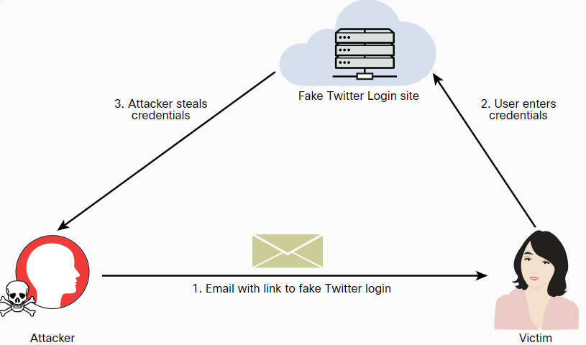
Researching Attack Vectors and Performing Attacks on Cloud Technologies
Credential Harvesting
Credential harvesting (or password harvesting) is the act of gathering and stealing valid usernames, passwords, tokens, PINs, and any other types of credentials through infrastructure breaches.
One of the most common ways that attackers perform credential harvesting is by using phishing and spear phishing emails with links that could redirect a user to a bogus site.
Notes:
7: Cloud, Mobile, and IoT Security 7.1: Researching Attack Vectors and Performing Attacks on Cloud Technologies 7.1.3: Credential Harvesting

Slide 12
Researching Attack Vectors and Performing Attacks on Cloud Technologies
Credential Harvesting (Cont.)
These steps show how easy it is to perform a social engineering attack and instantiate a fake website (in this case, a fake Twitter login site) to perform a credential harvesting attack.
Step 1. Launch SET by entering the setoolkit command.
Step 2. Select 1) Social-Engineering Attacks from the main menu.
Step 3. In the menu that appears, select 2) Website Attack Vectors.
Step 4. In the menu and explanation that appear next, select 3) Credential Harvester Attack Method.
Step 5. In the menu that appears next select 1) Web Templates to use a predefined web template (Twitter).
Step 6. In the menu, enter the IP address of the host that you would like to use to harvest the user credentials (in this case, 192.168.88.225).
Step 7. Select 3. Twitter
Notes:
7: Cloud, Mobile, and IoT Security 7.1: Researching Attack Vectors and Performing Attacks on Cloud Technologies 7.1.3: Credential Harvesting (Cont.)

Slide 13
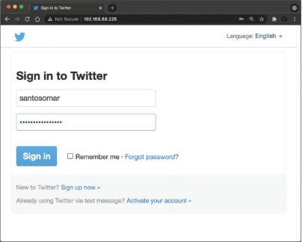
Researching Attack Vectors and Performing Attacks on Cloud Technologies
Credential Harvesting (Cont.)
You can then redirect users to this fake Twitter site by sending a spear phishing email or taking advantage of web vulnerabilities such as cross-site scripting (XSS) and cross-site request forgery (CSRF).
Attackers have been known to harvest cloud service provider credentials once they get into their victims’ systems. Different threat actors have extended their credential harvesting capabilities to target multiple cloud and non-cloud services in victims’ internal networks and systems after the exploitation of other vulnerabilities.
Notes:
7: Cloud, Mobile, and IoT Security 7.1: Researching Attack Vectors and Performing Attacks on Cloud Technologies 7.1.3: Credential Harvesting (Cont.)
7.1.4: Practice - Credential Harvesting

Slide 14
Researching Attack Vectors and Performing Attacks on Cloud Technologies
Privilege Escalation
Privilege escalation is the act of exploiting a bug or design flaw in a software or firmware application to gain access to resources that normally would have been protected from an application or a user. This results in a user gaining additional privileges beyond what the application developer originally intended.
Attackers take advantage of this to gain access to protected areas of operating systems or to applications (for example, reading another user’s email without authorization).
These are two different types of privilege escalation:
Vertical Privilege Escalation - This type of privilege escalation, also called privilege elevation, occurs when a lower-privileged user accesses functions reserved for higher-privileged users.
Horizontal Privilege Escalation - This type of privilege escalation occurs when a normal user accesses functions or content reserved for other normal users.
Notes:
7: Cloud, Mobile, and IoT Security 7.1: Researching Attack Vectors and Performing Attacks on Cloud Technologies 7.1.5: Privilege Escalation

Slide 15
Researching Attack Vectors and Performing Attacks on Cloud Technologies
Account Takeover
In an account takeover, the threat actor gains access to a user or application account and uses it to then gain access to more accounts and information. There are different ways that an account takeover can happen in the cloud.
There are a number of ways to detect account takeover attacks.
Login location
Failed login attempts
Lateral phishing emails
Malicious Oauth, SAML, or OpenID Connect connections
Abnormal file sharing and downloading
Notes:
7: Cloud, Mobile, and IoT Security 7.1: Researching Attack Vectors and Performing Attacks on Cloud Technologies 7.1.6: Account Takeover

Slide 16
Researching Attack Vectors and Performing Attacks on Cloud Technologies
Metadata Service Attacks
When an application requires access to specific assets, it can query the metadata service to get a set of temporary access credentials.
This temporary set of credentials can then be used to access services such as AWS Simple Cloud Storage (S3) buckets and other resources.
Metadata services are some of the most attractive services on AWS for an attacker to access.
If you are able to access these resources, at the very least, you will get a set of valid AWS credentials to interface with the API.
Software developers often include sensitive information in user startup scripts.
Notes:
7: Cloud, Mobile, and IoT Security 7.1: Researching Attack Vectors and Performing Attacks on Cloud Technologies 7.1.7: Metadata Service Attacks

Slide 17
Researching Attack Vectors and Performing Attacks on Cloud Technologies
Attacks Against Misconfigured Cloud Assets
Attackers can leverage misconfigured cloud assets in a number of ways:
Identity and Access Management (IAM) implementations - If an attacker is able to manipulate a cloud-based IAM solution in an IaaS or PaaS environment, it could be catastrophic for the cloud consumer,
Federation Misconfigurations - Federated authentication (or federated identity) is a method of associating a user’s identity across different identity management systems. Often application developers misconfigure the implementation of the underlying protocols used in a federated identity environment (such as SAML, OAuth, and OpenID).
Object Storage - Insecure permission configurations for cloud object storage services, such as Amazon’s AWS S3 buckets, are often the cause of data breaches.
Containerization Technologies - Attacks against container-based deployments (such as Docker, Rocket, LXC, and containerd) have led to massive data breaches. Often attackers use stolen credentials or known vulnerabilities to compromise cloud-based applications.
Notes:
7: Cloud, Mobile, and IoT Security 7.1: Researching Attack Vectors and Performing Attacks on Cloud Technologies 7.1.8: Attacks Against Misconfigured Cloud Assets

Slide 18
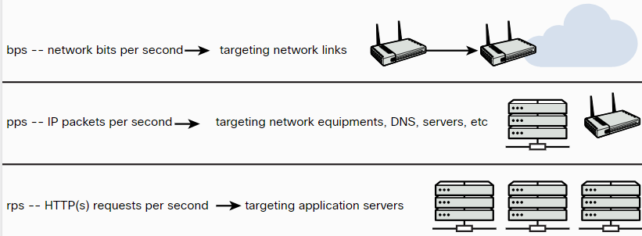
Researching Attack Vectors and Performing Attacks on Cloud Technologies
Resource Exhaustion and DoS Attacks
One of the benefits of leveraging cloud services is the distributed and resilient architecture that most leading cloud providers offer.
This architecture helps minimize the impact of a DoS or distributed denial-of-service (DDoS) attack compared to what it would be if you were hosting your application on premises in your data center.
Notes:
7: Cloud, Mobile, and IoT Security 7.1: Researching Attack Vectors and Performing Attacks on Cloud Technologies 7.1.9: Resource Exhaustion and DoS Attacks

Slide 19
Researching Attack Vectors and Performing Attacks on Cloud Technologies
Resource Exhaustion and DoS Attacks (Cont.)
Attackers can launch more strategic DoS attacks against applications hosted in the cloud that could lead to resource exhaustion.
Another example of a DoS attack that can affect cloud environments is the direct-to-origin (D2O) attack.
In a D2O attack, threat actors are able to reveal the origin network or IP address behind a content delivery network (CDN) or large proxy placed in front of web services in a cloud provider.
A D2O attack could allow attackers to bypass different anti-DDoS mitigations.
Notes:
7: Cloud, Mobile, and IoT Security 7.1: Researching Attack Vectors and Performing Attacks on Cloud Technologies 7.1.9: Resource Exhaustion and DoS Attacks (Cont.)

Slide 20
Researching Attack Vectors and Performing Attacks on Cloud Technologies
Cloud Malware Injection Attacks
Cloud deployments are susceptible to malware injection attacks.
In a cloud malware injection attack, the attacker creates a malicious application and injects it into a SaaS, PaaS, or IaaS environment.
Once the malware injection is completed, the malware is executed as one of the valid instances running in the cloud infrastructure.
Subsequently, the attacker can leverage this foothold to launch additional attacks, such as covert channels, backdoors, eavesdropping, data manipulation, and data theft.
Notes:
7: Cloud, Mobile, and IoT Security 7.1: Researching Attack Vectors and Performing Attacks on Cloud Technologies 7.1.10: Cloud Malware Injection Attacks

Slide 21
Researching Attack Vectors and Performing Attacks on Cloud Technologies
Side-Channel Attacks
Side-channel attacks are often based on information gained from the implementation of the underlying computer system (or cloud environment) instead of a specific weakness in the implemented technology or algorithm.
The attacker aims to gather information from or influence an application or a system by measuring or exploiting indirect effects of the system or its hardware.
Most side-channel attacks are used to exfiltrate credentials, cryptographic keys, and other sensitive information by measuring coincidental hardware emissions.
Side-channel attacks can be used against VMs and in cloud computing environments where a compromised system controlled by the attacker and target share the same physical hardware.
Notes:
7: Cloud, Mobile, and IoT Security 7.1: Researching Attack Vectors and Performing Attacks on Cloud Technologies 7.1.11: Side-Channel Attacks
7.1.12: Practice - Cloud Attack Types

Slide 22
Researching Attack Vectors and Performing Attacks on Cloud Technologies
Tools and Software Development Kits (SDKs)
Documents such as Swagger and the OpenAPI Specification documents can help you greatly when you are assessing API implementations.
Software development kits (SDKs) and cloud development kits (CDKs) can provide great insights about cloud-hosted applications, as well as the underlying infrastructure.
An SDK is a collection of tools and resources to help with the creation of applications (on premises or in the cloud).
CDKs, on the other hand, help software developers and cloud consumers deploy applications in the cloud and use the resources that the cloud provider offers.
Notes:
7: Cloud, Mobile, and IoT Security 7.1: Researching Attack Vectors and Performing Attacks on Cloud Technologies 7.1.13: Tools and Software Development Kits (SDKs)

Slide 23
7.2 Explaining Common Attacks and Vulnerabilities Against Specialized Systems
Notes:
7: Cloud, Mobile, and IoT Security 7.2: Explaining Common Attacks and Vulnerabilities Against Specialized Systems

Slide 24
Explaining Common Attacks and Vulnerabilities Against Specialized Systems
Overview
In this section, you will learn about a variety of attacks against mobile devices, Internet of Things (IoT) devices, data storage system vulnerabilities, vulnerabilities affecting VMs, and containerized applications and workloads.
Notes:
7: Cloud, Mobile, and IoT Security 7.2: Explaining Common Attacks and Vulnerabilities Against Specialized Systems 7.2.1: Overview

Slide 25
Explaining Common Attacks and Vulnerabilities Against Specialized Systems
Attacking Mobile Devices
Attackers use various techniques to compromise mobile devices:
Reverse Engineering - The process of analyzing the compiled mobile app to extract information about its source code could be used to understand the underlying architecture of a mobile application and potentially manipulate the mobile device.
Sandbox Analysis - iOS and Android apps are isolated from each other via sandbox environments. Sandboxes in mobile devices are a mandatory access control mechanism describing the resources that a mobile app can and can’t access. An attacker could perform detailed analysis of the sandbox implementation in a mobile device to potentially bypass the access control mechanisms.
Spamming – SMS attacks continue to be some of the most common attacks against mobile users. In such an attack, a user may be presented with links that could redirect to malicious sites to steal sensitive information or install malware.
Notes:
7: Cloud, Mobile, and IoT Security 7.2: Explaining Common Attacks and Vulnerabilities Against Specialized Systems
7.2.2: Attacking Mobile Devices

Slide 26
Explaining Common Attacks and Vulnerabilities Against Specialized Systems
Attacking Mobile Devices (Cont.)
The following are some of the most prevalent vulnerabilities affecting mobile devices:
Insecure storage - Mobile app developers often do not use these secure storage APIs successfully, and an attacker could leverage these vulnerabilities.
Passcode vulnerabilities and biometrics integrations - Vulnerabilities in these integrations could lead to sensitive data exposure and full compromise of the mobile device.
Certificate pinning - The idea is to force the mobile app to store the server certificate or public key and subsequently establish connections only to the trusted/known server (referred to as “pinning” the server). The goal of certificate pinning is to reduce the attack surface by removing the trust in external CAs.
Using known vulnerable components - Attackers may leverage known vulnerabilities against the underlying mobile operating system, or dependency vulnerabilities (that is, vulnerabilities in dependencies of a mobile application).
Execution of activities using root and over-reach of permissions - Application developers must practice the least privilege concept.
Business logic vulnerabilities - An attacker can use legitimate transactions and flows of an application in a way that results in a negative behavior or outcome.
Notes:
7: Cloud, Mobile, and IoT Security 7.2: Explaining Common Attacks and Vulnerabilities Against Specialized Systems
7.2.2: Attacking Mobile Devices (Cont.)

Slide 27
Explaining Common Attacks and Vulnerabilities Against Specialized Systems
Attacking Mobile Devices (Cont.)
These are some of the tools most commonly used to perform security research and test the security posture of mobile devices:
Burp Suite
Drozer
needle
Mobile Security Framework (MobSF)
Postman
Ettercap
Frida
Objection
Android SDK tools
ApkX
APK Studio
Notes:
7: Cloud, Mobile, and IoT Security 7.2: Explaining Common Attacks and Vulnerabilities Against Specialized Systems
7.2.2: Attacking Mobile Devices (Cont.)
7.2.3: Practice - Mobile Device Vulnerabilities
7.2.4: Practice - Attacking Mobile Devices

Slide 28
Explaining Common Attacks and Vulnerabilities Against Specialized Systems
Attacking Internet of Things (IoT) Devices
IoT is an incredibly broad term that can be applied across personal devices, industrial control systems (ICS), transportation, and many other businesses and industries.
Managing and orchestrating IoT systems introduces additional complexity due to disparate hardware and software, the use of legacy technologies, and, often, multiple vendors and integrators.
IoT platforms must integrate a wide range of IoT edge devices with varying device constraints and must be integrated to back-end business applications.
IoT environments span a range of components that include sensors, gateways, network connectivity, applications, and cloud infrastructure.
The unfortunate reality is that most IoT security efforts today focus on only a few elements of the entire system. A secure IoT platform should provide the complete end-to-end infrastructure to build an IoT solution, including the software, management, and security to effectively collect, transform, transport, and deliver data to provide business value.
Notes:
7: Cloud, Mobile, and IoT Security 7.2: Explaining Common Attacks and Vulnerabilities Against Specialized Systems
7.2.5: Attacking Internet of Things (IoT) Devices

Slide 29
Explaining Common Attacks and Vulnerabilities Against Specialized Systems
Analyzing IoT Protocols
Some of the most common network protocols for IoT implementations include the following:
Wi-Fi
Bluetooth and Bluetooth Low Energy (BLE)
Zigbee
Z-Wave
LoraWAN
Insteon
Modbus
Siemens S7comm (S7 Communication)
Notes:
7: Cloud, Mobile, and IoT Security 7.2: Explaining Common Attacks and Vulnerabilities Against Specialized Systems
7.2.6: Analyzing IoT Protocols

Slide 30
Explaining Common Attacks and Vulnerabilities Against Specialized Systems
Analyzing IoT Protocols (Cont.)
Bluetooth Low Energy (BLE) is used by IoT home devices, medical, industrial, and government equipment.
You can analyze protocols such as BLE by using specialized antennas and equipment such as the Ubertooth One. BLE involves a three-phase process to establish a connection:
Phase 1. Pairing feature exchange
Phase 2. Short-term key generation
Phase 3. Transport-specific key distribution
BLE implements a number of cryptographic functions.
It supports AES for encryption and key distribution exchange to share different keys among the BLE-enabled devices.
However, many devices that support BLE do not even implement the BLE-layer encryption.
In addition, mobile apps cannot control the pairing, which is done at the operating system level.
Attackers can scan BLE devices or listen to BLE advertisements and leverage these misconfigurations.
Then they can advertise clone/ fake BLE devices and perform on-path (formerly known as man-in-the-middle) attacks.
Notes:
7: Cloud, Mobile, and IoT Security 7.2: Explaining Common Attacks and Vulnerabilities Against Specialized Systems
7.2.6: Analyzing IoT Protocols (Cont.)
7.2.7: Practice - Analyzing IoT Protocols

Slide 31
Explaining Common Attacks and Vulnerabilities Against Specialized Systems
IoT Security Special Considerations
These are a few special considerations to keep in mind when trying to secure IoT implementations:
Fragile Environment - Many IoT devices (including sensors and gateways) have limited compute resources. Because of this lack of resources, some security features, including encryption, may not even be supported in IoT devices.
Availability Concerns - DoS attacks against IoT systems are a major concern.
Data Corruption - IoT protocols are often susceptible to input validation vulnerabilities, as well as data corruption issues.
Data Exfiltration - IoT devices could be manipulated by an attacker and used for sensitive data exfiltration.
Notes:
7: Cloud, Mobile, and IoT Security 7.2: Explaining Common Attacks and Vulnerabilities Against Specialized Systems
7.2.8: IoT Security Special Considerations

Slide 32
Explaining Common Attacks and Vulnerabilities Against Specialized Systems
Common IoT Vulnerabilities
These are some of the most common security vulnerabilities affecting IoT implementations:
Insecure defaults - Default credentials and insecure default configurations are often concerns with IoT devices. You will find hundreds of IoT devices with default credentials and insecure configurations exposed on the Internet.
Plaintext communication and data leakage - Even if encryption is supported, many IoT devices fail to implement encrypted communications, and an attacker could easily steal sensitive information.
Hard-coded configurations - Often IoT vendors sell their products with hard-coded insecure configurations or credentials.
Outdated firmware/hardware and the use of insecure or outdated components - Many organizations continue to run outdated software and hardware in their IoT devices. In some cases, some of these devices are never updated!
Notes:
7: Cloud, Mobile, and IoT Security 7.2: Explaining Common Attacks and Vulnerabilities Against Specialized Systems
7.2.9: Common IoT Vulnerabilities
7.2.10: Practice - Common IoT Vulnerabilities

Slide 33
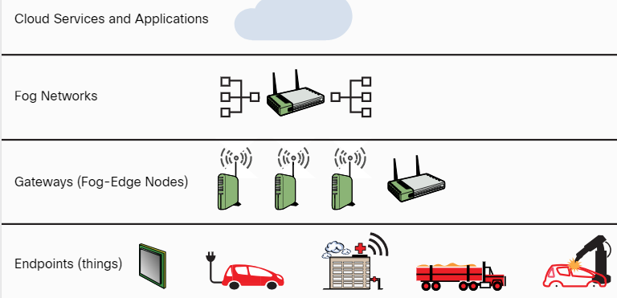
Explaining Common Attacks and Vulnerabilities Against Specialized Systems
Data Storage System Vulnerabilities
IoT architectures extend from IoT endpoint devices (things) to intermediary “fog” networks and cloud computing.
Gateways and edge nodes are devices such as switches, routers, and computing platforms that act as intermediaries (“the fog layer”) between the endpoints and the higher layers of the IoT system.
The IoT architectural hierarchy high-level layers:
Figure 7-4 - IoT Architecture Layers
Notes:
7: Cloud, Mobile, and IoT Security 7.2: Explaining Common Attacks and Vulnerabilities Against Specialized Systems
7.2.11: Data Storage System Vulnerabilities

Slide 34
Explaining Common Attacks and Vulnerabilities Against Specialized Systems
Data Storage System Vulnerabilities (Cont.)
The following are some of the most common misconfigurations of IoT devices and cloud-based solutions:
Default/blank username/password – Hardcoded or default credentials are often left in place by administrators and in some cases by software developers, exposing devices or the cloud environment to different attacks.
Network exposure – Many IoT, ICS, and SCADA systems should never be exposed to the Internet.
Lack of user input sanitization - Input validation vulnerabilities in protocols such as Modbus, S7 Communication, DNP3, and Zigbee could lead to DoS and code execution.
Underlying software vulnerabilities and injection vulnerabilities – Attackers can inject malicious SQL statements after “escaping input” by using the single quote method. IoT systems can be susceptible to similar vulnerabilities.
Error messages and debug handling - Many IoT systems include details in error messages and debugging output that can allow an attacker to obtain sensitive information from the system and underlying network.
Notes:
7: Cloud, Mobile, and IoT Security 7.2: Explaining Common Attacks and Vulnerabilities Against Specialized Systems
7.2.11: Data Storage System Vulnerabilities (Cont.)

Slide 35
Explaining Common Attacks and Vulnerabilities Against Specialized Systems
Management Interface Vulnerabilities
The Intelligent Platform Management Interface (IPMI) is a collection of compute interface specifications (often used by IoT systems) designed to offer management and monitoring capabilities independently of the host system’s CPU, firmware, and operating system.
System administrators can use IPMI to enable out-of-band management of computer systems (including IoT systems) and to monitor their operation.
An IPMI subsystem includes a main controller, called a baseboard management controller (BMC), and other management controllers, called satellite controllers.
The satellite controllers within the same physical device connect to the BMC via the system interface called Intelligent Platform Management Bus/Bridge (IPMB).
The BMC, which has direct access to the system’s motherboard and other hardware, may be leveraged to compromise the system.
If you compromise the BMC, it will provide you with the ability to monitor, reboot, and even potentially install implants (or any other software) in the system.
Notes:
7: Cloud, Mobile, and IoT Security 7.2: Explaining Common Attacks and Vulnerabilities Against Specialized Systems
7.2.12: Management Interface Vulnerabilities
7.2.13: Practice - Management Interface Vulnerabilities

Slide 36
Explaining Common Attacks and Vulnerabilities Against Specialized Systems
Exploiting Virtual Machines
A VM is supposed to be a completely isolated system. One VM should not have access to resources and data from another VM unless that is strictly allowed and configured.
The hypervisor is the entity that controls and manages the VMs. There are two types of hypervisors:
Type 1 hypervisors (also known as native or bare-metal hypervisors) run directly on the physical (bare-metal) system. Type 2, or hosted, hypervisors run on top of other operating systems. These virtual systems have been susceptible to many vulnerabilities, including the following:
VM escape vulnerabilities: These vulnerabilities allow an attacker to “escape” the VM and obtain access to other virtual machines on the system or access to the hypervisor.
Hypervisor vulnerabilities such as hyperjacking: Hyperjacking is a vulnerability that could allow an attacker to control the hypervisor. Hyperjacking attacks often require the installation of a malicious (or “fake”) hypervisor that can manage the entire virtual environment.
VM repository vulnerabilities: Attackers can leverage these vulnerabilities to compromise many systems and applications. There are many public and private VM repositories that users can leverage to deploy VMs. Attackers have found ways to upload fake or impersonated VMs with malicious software and backdoors.
Notes:
7: Cloud, Mobile, and IoT Security 7.2: Explaining Common Attacks and Vulnerabilities Against Specialized Systems
7.2.11: Data Storage System Vulnerabilities
7.2.14: Exploiting Virtual Machines

Slide 37
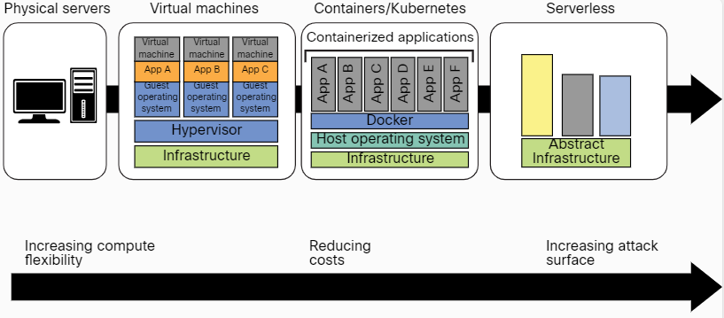
Explaining Common Attacks and Vulnerabilities Against Specialized Systems
Vulnerabilities Related to Containerized Workloads
Computing has evolved from traditional physical (bare-metal) servers to VMs, containers, and serverless architectures.
Figure 7-7 - The Evolution of Computing
Notes:
7: Cloud, Mobile, and IoT Security 7.2: Explaining Common Attacks and Vulnerabilities Against Specialized Systems
7.2.15: Vulnerabilities Related to Containerized Workloads

Slide 38
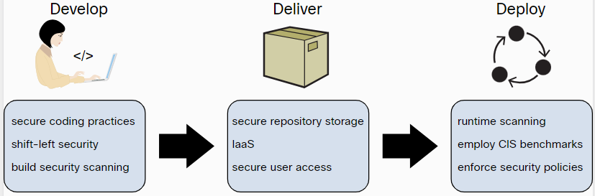
Explaining Common Attacks and Vulnerabilities Against Specialized Systems
Vulnerabilities Related to Containerized Workloads (Cont.)
Vulnerabilities in applications and in open-source software running in containers such as Docker, Rocket, and containerd are often overlooked by developers and IT staff. Attackers may take advantage of these vulnerabilities to compromise applications and data.
Three key security best practices that organizations should use to create a secure container image:
Figure 7-8 - Securing Container Images
Notes:
7: Cloud, Mobile, and IoT Security 7.2: Explaining Common Attacks and Vulnerabilities Against Specialized Systems
7.2.15: Vulnerabilities Related to Containerized Workloads (Cont.)

Slide 39
Explaining Common Attacks and Vulnerabilities Against Specialized Systems
Vulnerabilities Related to Containerized Workloads (Cont.)
Many tools allow you to scan Docker images for vulnerabilities and assess Kubernetes deployments. The following are a few examples of these tools:
Anchore’s Grype - Grype is an open-source container vulnerability scanner
Clair – Another open-source container vulnerability scanner
Dagda - This set of open-source static analysis tools can help detect vulnerabilities, Trojans, backdoors, and malware in Docker images and containers
kube-bench - This open-source tool performs a security assessment of Kubernetes clusters based on the CIS Kubernetes Benchmark.
kube-hunter - This open-source tool is designed to check the security posture of Kubernetes clusters.
Falco – A threat detection engine for Kubernetes
Another strategy that threat actors have used for years is to insert malicious code into Docker images on Docker Hub
Notes:
7: Cloud, Mobile, and IoT Security 7.2: Explaining Common Attacks and Vulnerabilities Against Specialized Systems
7.2.15: Vulnerabilities Related to Containerized Workloads (Cont.)
7.2.16: Practice - Vulnerabilities Related to Containerized Workloads

Slide 40
7.3 Summary
Notes:
7: Cloud, Mobile, and IoT Security 7.3: Summary

Slide 41
Summary
What Did I Learn in this Module?
The cloud presents a network without a perimeter, there is no border between a traditional internal network and external users as there is when resources are housed on-site.
This lack of perimeter increases reliance on access control, cloud configuration, and network architecture for security.
Mobile and IoT devices often communicate with applications hosted in the cloud. All these technologies and architectures increase the attack surface and introduce a variety of cybersecurity risks.
Cloud computing security includes many of the same functionalities as traditional IT security, including protecting critical information from theft, data exfiltration, and deletion, as well as privacy.
Cloud computing can be broken into the following three basic models:
Infrastructure as a Service (IaaS)
Platform as a Service (PaaS)
Software as a Service (SaaS)
Notes:
7: Cloud, Mobile, and IoT Security 7.3: Summary 7.3.1: What Did I Learn in this Module?

Slide 42
Summary
What Did I Learn in this Module? (Cont.)
Credential harvesting (or password harvesting) is the act of gathering and stealing valid usernames, passwords, tokens, PINs, and any other types of credentials through infrastructure breaches.
Privilege escalation is the act of exploiting a bug or design flaw in a software or firmware application to gain access to resources that normally would have been protected from an application or a user.
In an account takeover, the threat actor gains access to a user or application account and uses it to then gain access to more accounts and information.
When an application requires access to specific assets, it can query the metadata service to get a set of temporary access credentials. This temporary set of credentials can then be used to access services such as AWS Simple Cloud Storage (S3) buckets and other resources.
Attackers can leverage misconfigured cloud assets.
Attackers can launch strategic DoS attacks against applications hosted in the cloud that could lead to resource exhaustion.
In a cloud malware injection attack, the attacker creates a malicious application and injects it into a SaaS, PaaS, or IaaS environment.
Side-channel attacks are often based on information gained from the implementation of the underlying computer system (or cloud environment) instead of a specific weakness in the implemented technology or algorithm.
Notes:
7: Cloud, Mobile, and IoT Security 7.3: Summary 7.3.1: What Did I Learn in this Module? (Cont.)

Slide 43
Summary
What Did I Learn in this Module? (Cont.)
Attackers use various techniques to compromise mobile devices.
A secure IoT platform should provide the complete end-to-end infrastructure to build an IoT solution, including the software, management, and security to effectively collect, transform, transport, and deliver data to provide business value.
In the IoT world, you will frequently encounter custom, proprietary, or new network protocols.
There are special considerations to keep in mind when trying to secure IoT implementations.
There are many security vulnerabilities affecting IoT implementations.
Misconfigurations in IoT on-premises and cloud-based solutions can lead to data theft.
IoT implementations have suffered from many management interface vulnerabilities.
Virtual machines have been susceptible to many vulnerabilities.
Vulnerabilities in applications and in open-source software running in containers are often overlooked by developers and IT staff. Attackers may take advantage of these vulnerabilities to compromise applications and data.
A number of tools allow you to scan Docker images for vulnerabilities and assess Kubernetes deployments.
Notes:
7: Cloud, Mobile, and IoT Security 7.3: Summary 7.3.1: What Did I Learn in this Module? (Cont.)

Slide 44
Summary
Reflection Questions
New technologies can improve our lives, but this comes at a cost. The internet of things (IoT) connects many devices that can lower costs and improve efficiency to the internet. These devices are small and often have limited computer processing capability. However, they can host server software and command line utilities. What is the impact of connecting hundreds of thousands of IoT devices to the internet?
Technologies such as the cloud, virtual machines, and containerized services add flexibility and power to software deployments. However, so much flexibility can cause problems. Why does widespread adoption of cloud services present challenges for security experts?
What is the responsibility of ethical hackers as regards IoT, cloud, and containerized services?
Notes:
7: Cloud, Mobile, and IoT Security 7.3: Summary 7.3.2: Reflection Questions
7.3.3: Quiz - Cloud, Mobile, and IoT Security

Slide 45
Module 7
Terms and Commands
Cloud API IaaS PaaS SaaS IoT Public cloud Private cloud Community cloud Hybrid cloud Credential harvesting SSO Federated authentication Privilege escalation DRM Vertical privilege escalation Horizontal privilege escalation | Account takeover Metadata service attacks Resource eshaustion DoS attack Searchsploit D2O attack Cloud malware injection attack Side-channel attack SDK CDK ICS SCADA IIoT BLE Fog IPMI
Notes:
7: Cloud, Mobile, and IoT Security 7.3: Summary Terms and Commands

